Slide 1

Intro to Azure and Data Platform
DSBA 6190-U91 | Colby T. Ford, Ph.D.

Slide 2
Overview
About Microsoft Azure
Structured Data Storage
Azure SQL DB
Azure SQL Data Warehouse
Unstructured Data Storage
Azure Storage
Azure Data Lake Store
Other Types
Azure CosmosDB
Streaming Data

Slide 3

Top Benefits of Cloud Computing
Types of Clouds
Service Offerings
Regions
https://azure.microsoft.com/en-us/overview/what-is-cloud-computing/

Slide 4
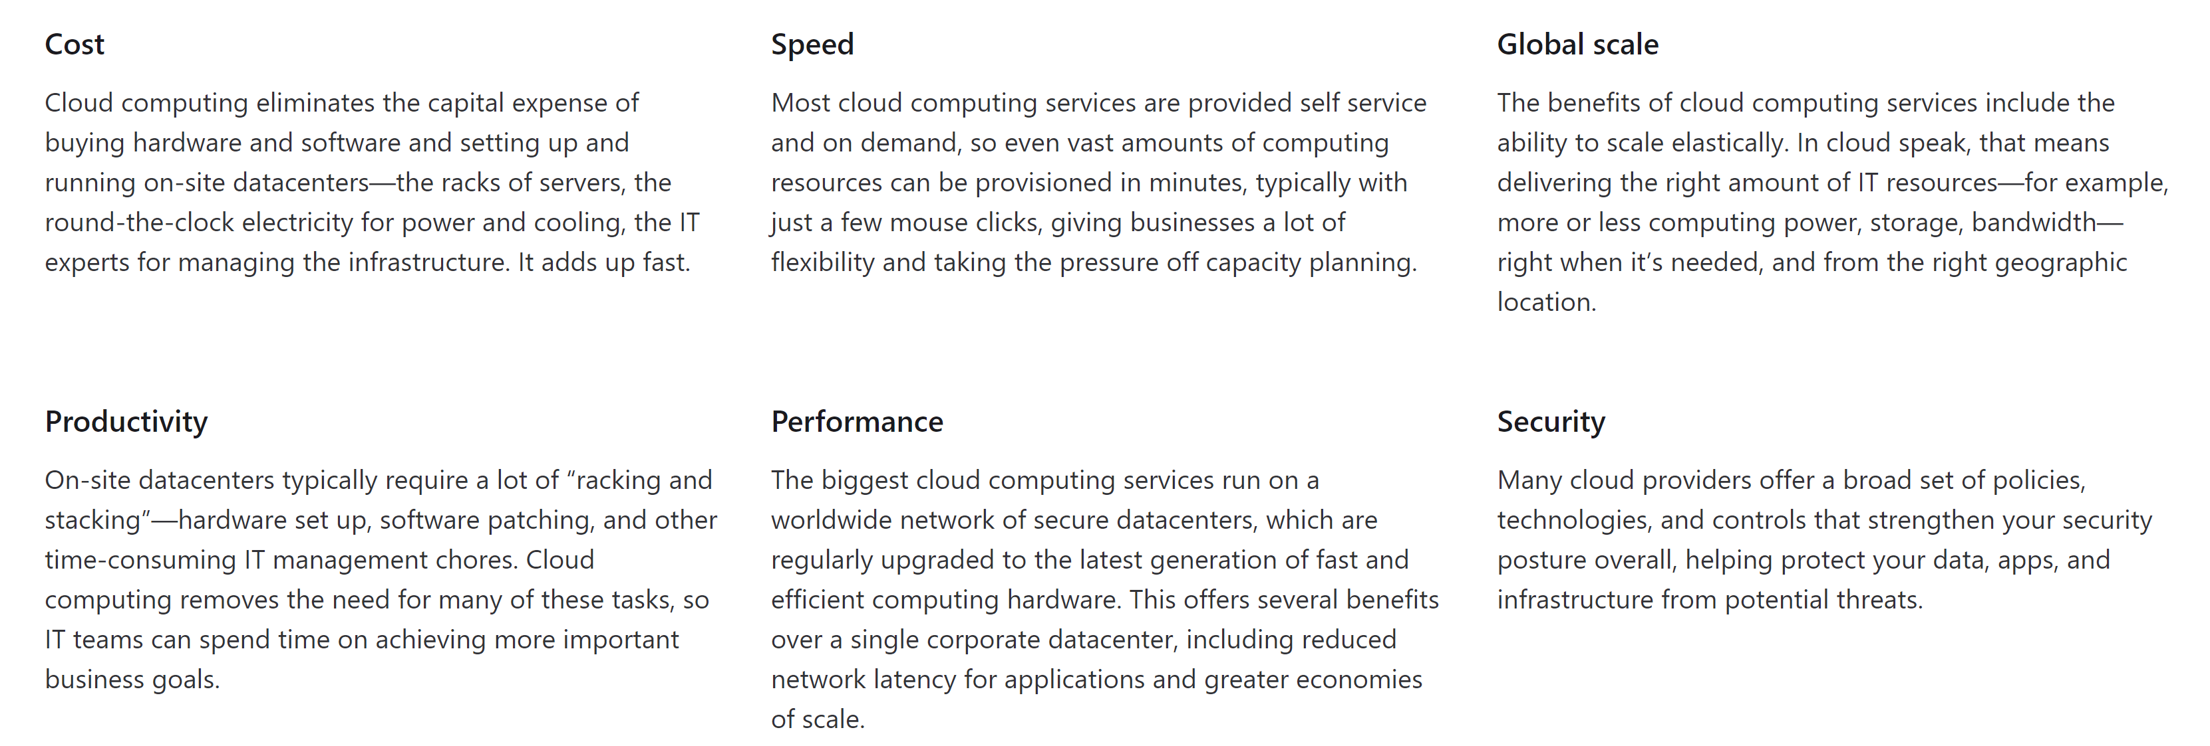
Top Benefits of Cloud Computing

Slide 5
Types of Clouds
Public Cloud
Private Cloud
Hybrid Cloud
Owned and operated by third-party cloud service providers
Deliver computing resources like servers and storage over the internet
Owned exclusively by a single business or organization
Can be physically located on the company's on-site datacenter
Could also be hosted by a third-party service provider, but maintained by the organization on a private network
Somewhere in the middle of public and private
Bound by technologies that allows data and applications to be shared between them
Most flexible option as it allows for a broad range of deployment options
Most control over security and compliance

Slide 6
Types of Cloud Services
PaaS
Services that provide on-demand environments for developing, testing, delivering, and managing software applications
No (less) need to manage underlying infrastructure
SaaS
Software
Delivery of software applications over the internet
Serverless
Overlaps with PaaS
Focuses on building app functionality without spending time managing the servers and infrastructures required to do so
IaaS
Most basic form of cloud computing services
Rent IT infrastructure
Includes:
VMs, Storage, Networks, Operating Systems
Infrastructure
Platform
Usually as an on-demand/subscription basis
Cloud provider hosts and manages the software application and underlying infrastructure
Usually highly-scalable and event-driven

Slide 7
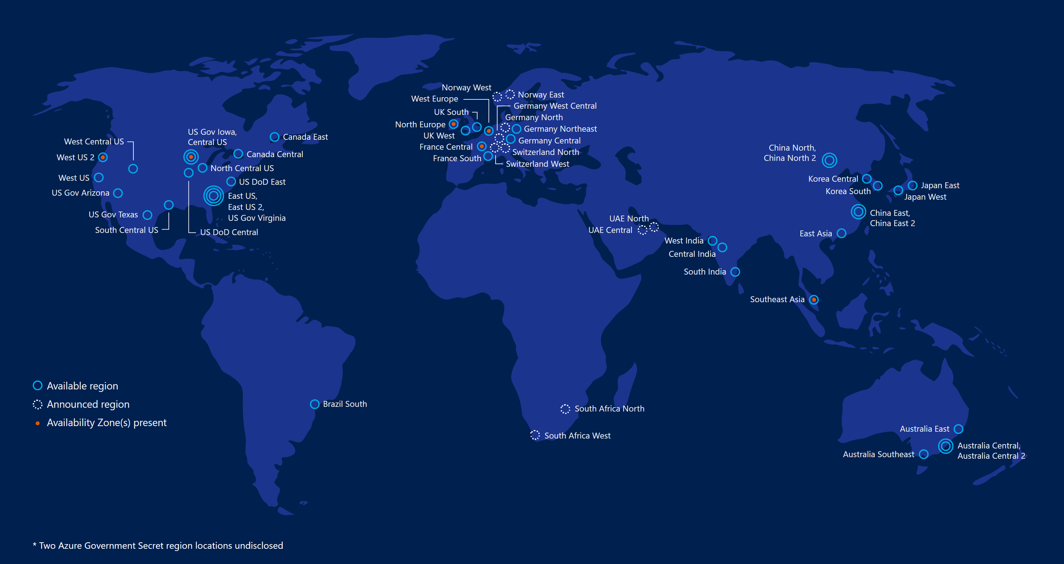
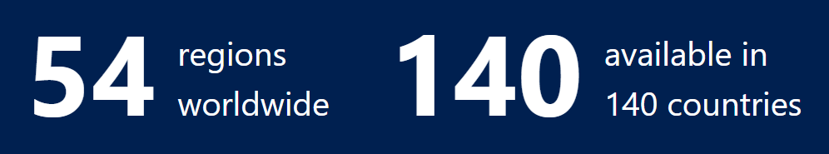
Azure Regions

Slide 8
Reasons to Select a Region
Speed
Pick a region that is the closest to you will help increase the speed of moving data in and out from your resources.
Cost
You will face egress fees if you move data from one region to another. So, it's cheaper for you to have everything nearby.
Some services are cheaper in certain regions over others. Using the Azure calculator can help you estimate the cost differences.
Available Resources
Certain services are only available in certain regions. It might not be possible to have everything in the same place. (See Products by Region.)
Security and Compliance
Depending on the scenario, a particular data center might need to be selected for security and compliance reasons. (Such as government or China)

Slide 9
Available Service Categories
AI + Machine Learning
Analytics
Compute
Containers
Databases
Developer Tools
DevOps
Identity
Integration
Internet of Things
Management and Governance
Media
Migration
Mobile
Networking
Security
Storage
Web
https://azure.microsoft.com/en-us/services/

Slide 10
Azure SQL Database
Azure SQL Data Warehouse
Other SQL-based Offerings
Structured Data Storage

Slide 11
Azure Storage
Azure Data Lake Store
Unstructured Data Storage

